Slide 1
IMAGE PROCESSING
SUPERVISOR :DR MAHMOUD ZAKI

Slide 2

Image Processing and Filtering Techniques
1. Introduction
This project demonstrates a comprehensive set of image processing techniques, including edge detection and both spatial and frequency domain filtering, applied in real-time using webcam input. The goal is to
analyzethe effectsof differentfilters and understand their practical applications.
2. System Overview
• Real-time video capture from the default webcam. • Keyboard-based mode selection for different filters. • Spatial domain filters operate directly on pixels. • Frequency domain filters manipulate the Fourier transform of images. • Processed frames are displayed with overlayed text showing the applied filter and parameters.
Program Flow:
[Start] → [Capture Frame from Camera] → [Check Key Press → Set Mode]
→ [Apply Selected Filter] → [Display Frame with Overlay Text]
→
[Loop
until 'q' pressed]
3. Edge Detection Filters
SobelX
• Function:
sobelx_func(frame, ksize)
• Description: Computes horizontal intensity changes. • Input: Color frame, kernel size. • Output: Grayscale image highlighting vertical edges.
Sobel Y
• Function:
sobely_func(frame, ksize)
• Description: Computes vertical intensity changes. • Input: Color frame, kernel size. • Output: Grayscale image highlighting horizontal edges.
Gradient Magnitude
• Function:
gradient_magnitude_func(sobelx, sobely)
• Description: Combines Sobel X & Y to compute edge strength. • Input: Sobel X and Y images. • Output: Grayscale image representing edge magnitude.
1

Slide 3




Canny Edge Detection
• Function:
Canny_edge_detection(frame, ksize)
• Description: Multi-stage edge detection using Gaussian blur, gradients, non-maximum suppression,
and double thresholding.
• Input: Color frame, kernel size. • Output: Binary edge map with strong and weak edges.
4. Frequency Domain Filters
Low-Pass Filters
1. ILPF (Ideal Low-Pass Filter) -
ILPF(frame, r)
2. GLPF (Gaussian Low-Pass Filter) -
GLPF(frame, r)
3. BLPF (Butterworth Low-Pass Filter) -
BLPF(frame, r, n)
High-Pass Filters
1. IHPF (Ideal High-Pass Filter) -
IHPF(frame, r)
2. GHPF (Gaussian High-Pass Filter) -
GHPF(frame, r)
3. BHPF (Butterworth High-Pass Filter) -
BHPF(frame, r, n)
All frequency filters use
reconstruct the image.
5. Spatial Domain Filters
DFT_and_reconstruct()
to compute the Fourier transform, apply filter mask, and
Mean Filters
1. Arithmetic Mean Filter - 2. Geometric Mean Filter - 3. Harmonic Mean Filter -
arithmetic_mean_filter(frame, ksize)
geometric_mean_filter(frame, ksize)
4. Contraharmonic Mean Filter -
harmonic_mean_filter(frame, ksize)
contraharmonic_mean_filter(frame, ksize, Q)
Order-Statistic Filters
1. Median Filter -
median_filter(img, k)
2. Min Filter - 3. Max Filter -
min_filter(img, k)
4. Midpoint Filter -
max_filter(img, k)
5. Alpha-Trimmed Mean Filter -
midpoint_filter(img, k)
alpha_trimmed_mean_filter(img, k, d)
6. Illustrative Image
Illustrative Image
2

Slide 4

7. Real-Time Processing Loop
• Captures framescontinuouslyfrom webcam (cv2.VideoCapture(0)).
• Reads key presses to set processing mode (e.g., 'x' → Sobel X, '1' → ILPF). • Dynamically adjusts parameters: kernel size, cutoff radius, contraharmonic Q. • Applies the selected filter and overlays text describing the mode.
Advantages: - Real-time visualization - Easy comparison of different filters - Dynamic parameter control
8. Conclusion
• Thesystemdemonstrates comprehensive image processing filters.
• Offers interactive real-time experience for learning spatial and frequency domain filtering.
• Useful foranalyzing edge detection, noise reduction, and image enhancement techniques.
9. References
1. Gonzalez,R.C., Woods, R.E., Digital Image Processing, 4th Edition, Pearson, 2018.
2. OpenCV Documentation: https://opencv.org 3. Tutorialspoint, Image Processing Basics: https://www.tutorialspoint.com/image_processing
3

Slide 5
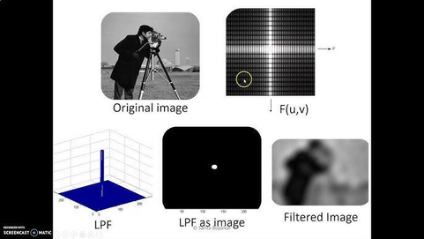
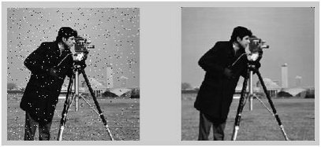
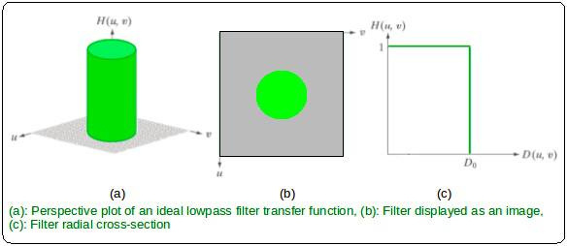
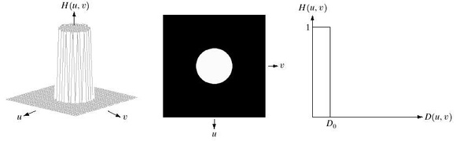
4. Frequency Domain Filters
Low-Pass Filters
1. ILPF (Ideal Low-Pass Filter) -
1. ILPF (Ideal Low-Pass Filter) -
keeps low-frequency components of the image (smooth areas) while completely blocking high-frequency components (edges and fine details), producing a blurred/smoothened image.

Slide 6
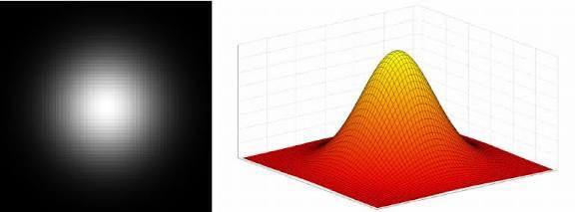
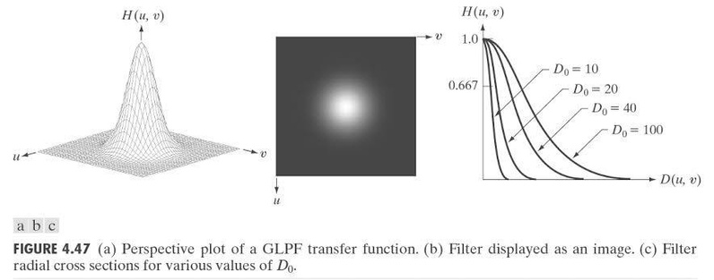
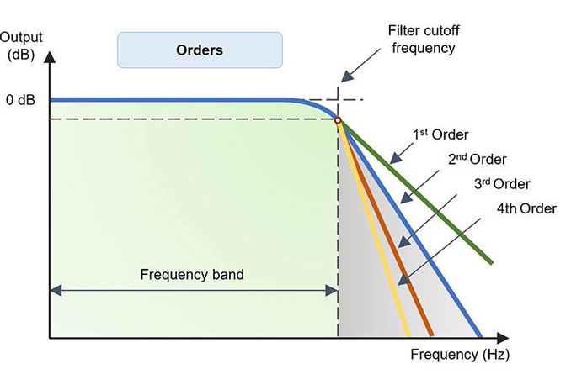
2. GLPF (Gaussian Low-Pass Filter) -
smooths the image by attenuating high frequencies gradually with a Gaussian curve, reducing noise while minimizing ringing artifacts compared to the ideal low-pass filter.
3. BLPF (Butterworth Low-Pass Filter) -
allows low frequencies to pass while attenuating high frequencies with a smooth, adjustable transition controlled by the filter order, balancing sharpness and smoothness.

Slide 7
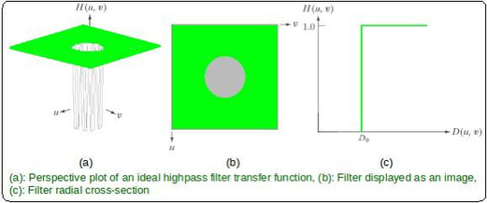
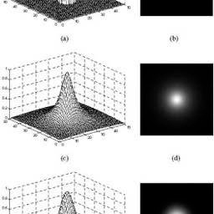
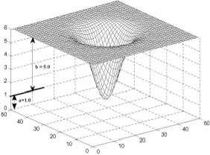
High-Pass Filters
1. IHPF (Ideal High-Pass Filter) -
blocks low-frequency components (smooth areas) and allows high frequencies (edges and fine details) to pass, enhancing image details and edges sharply.
2. GHPF (Gaussian High-Pass Filter) -
emphasizes edges and fine details by attenuating low frequencies gradually using a Gaussian function, producing smoother high-pass enhancement with minimal ringing artifacts.

Slide 8
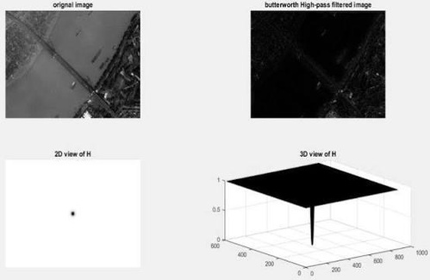
3. BHPF (Butterworth High-Pass Filter) -
enhances edges by reducing low frequencies with a smooth transition controlled by the filter order, providing adjustable sharpness while avoiding abrupt artifacts.

Slide 9
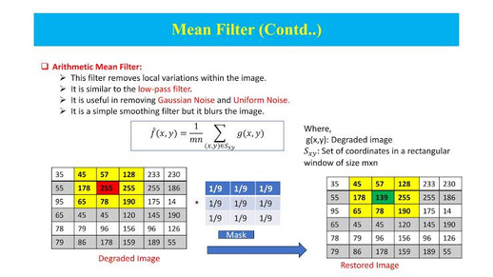
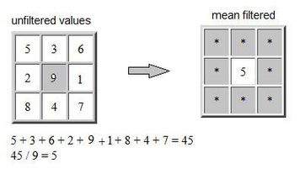
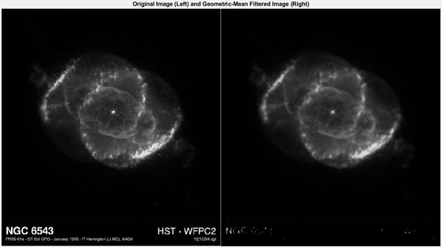
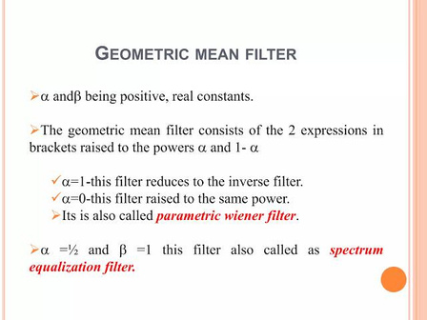
5. Spatial Domain Filters
Mean Filters
1. Arithmetic Mean Filter
smooths an image by replacing each pixel with the average of its neighborhood, reducing random noise but also slightly blurring edges.
2. Geometric Mean Filte
smooths an image by replacing each pixel with the geometric mean of its neighborhood, reducing noise while better preserving edges compared to the arithmetic mean filter.

Slide 10
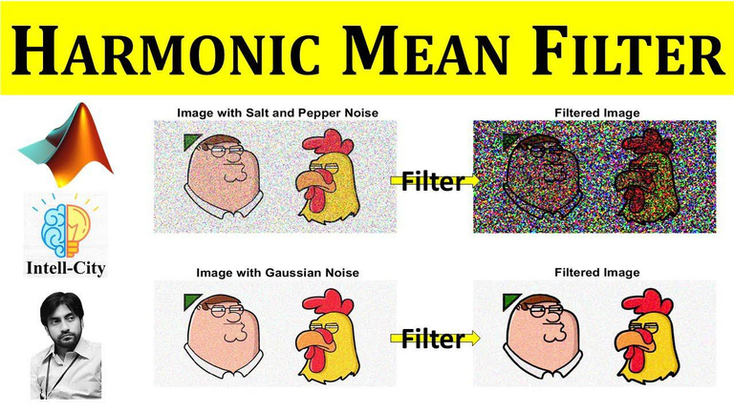
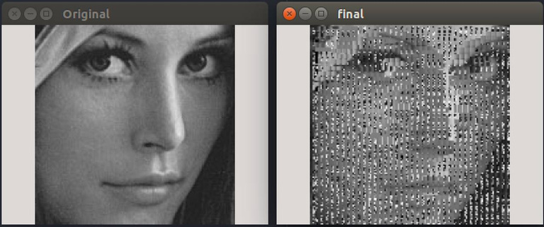
3. Harmonic Mean Filte
reduces the effect of bright noise (e.g., salt noise) by replacing each pixel with the harmonic mean of its neighborhood, preserving dark regions.
4. Contraharmonic Mean Filter
reduces salt-and-pepper noise by replacing each pixel with a contraharmonic mean of its neighborhood; the parameter Q controls whether it removes salt noise (Q > 0) or pepper noise (Q < 0).

Slide 11
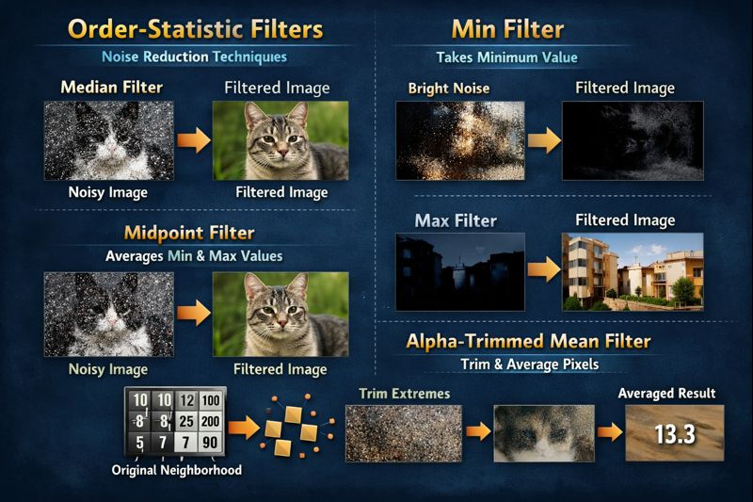
Order-Statistic Filters – operate based on the sorted values of a pixel’s neighborhood rather than arithmetic calculations.
Median Filter – replaces each pixel with the median value of its neighborhood; for removing impulse (salt-and-pepper) noise while preserving edges
Min Filter – replaces each pixel with the minimum value in its neighborhood; removes bright noise and performs morphological erosion.
Max Filter – replaces each pixel with the maximum value in its neighborhood; removes dark noise and performs morphological dilation.
Midpoint Filter – replaces each pixel with the average of the minimum and
values in its neighborhood; balances noise reduction and edge preservation.
Alpha-Trimmed Mean Filter – removes a specified number of the lowest and highest pixel values in the neighborhood, then averages the remaining values; effective for mixed noise reduction while preserving details.

Slide 12
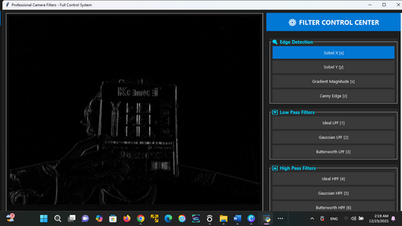
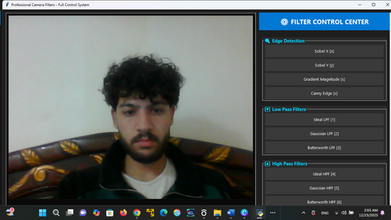
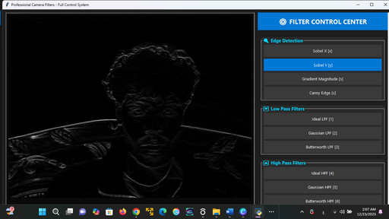
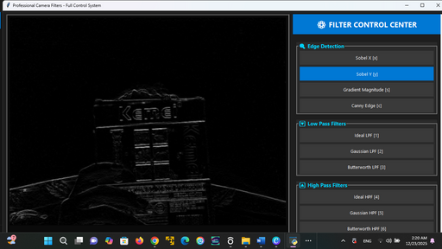
SOPEL X
SOPEL Y

Slide 13
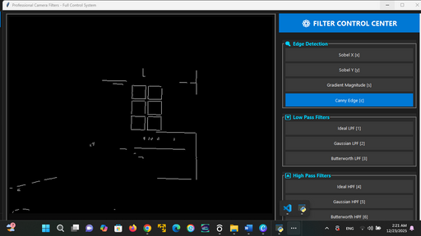
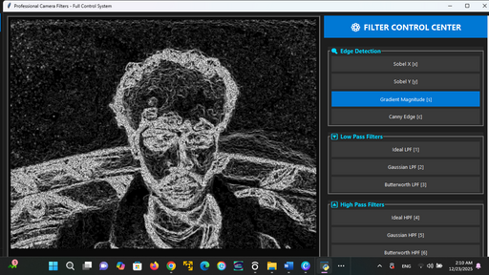
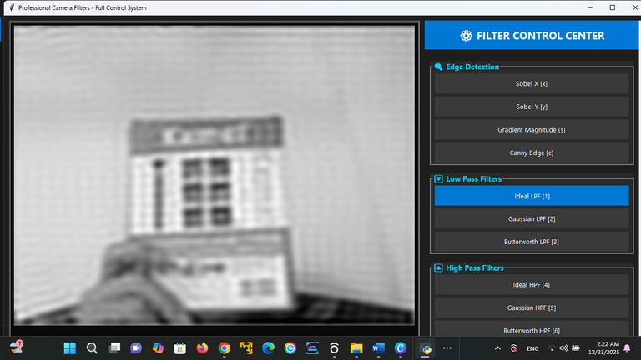
CANY
IDEAL LPF

Slide 14
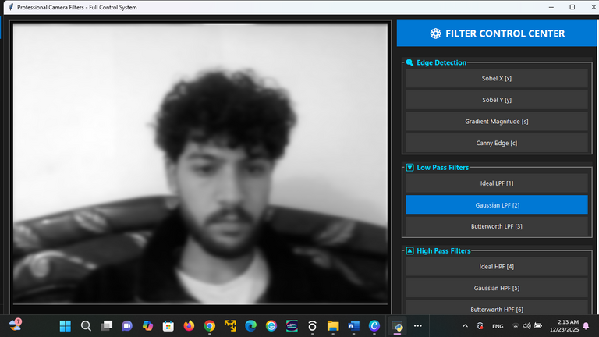
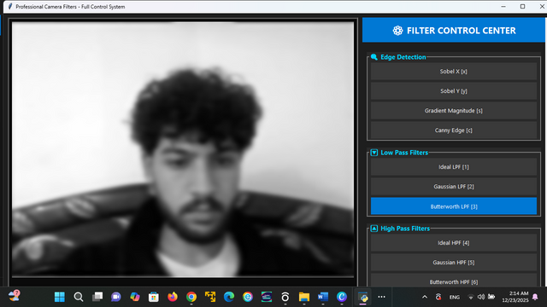
GAUSSAN LPF
bUTTERWORTH LPF

Slide 15
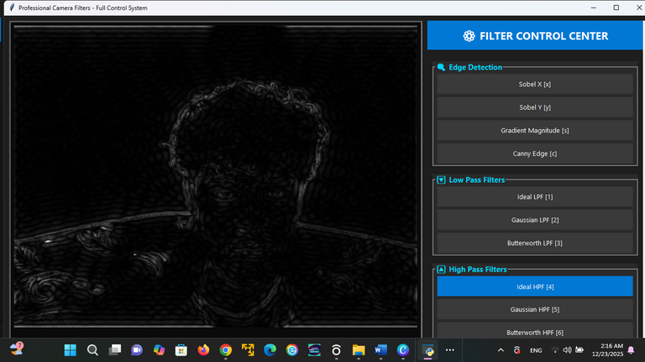
IDEAL HPF

Slide 16
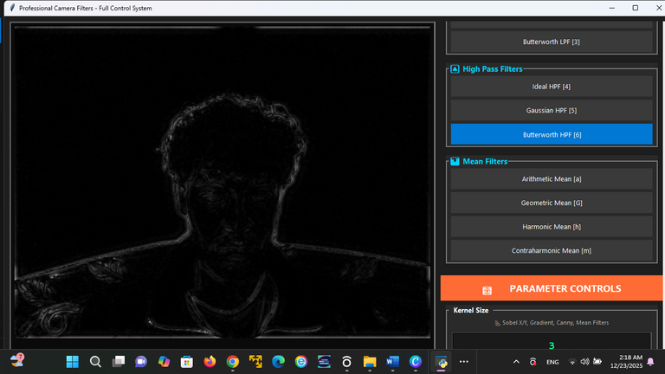
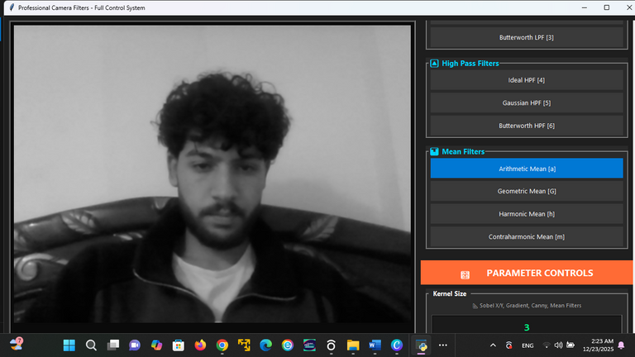
bUTTERWORTH HPF
ARITHMITIC MEAN

Slide 17
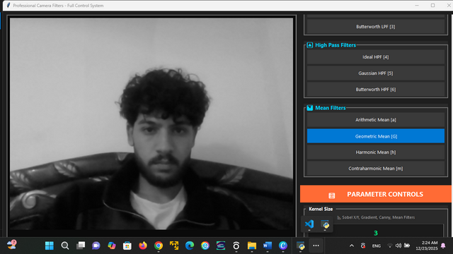
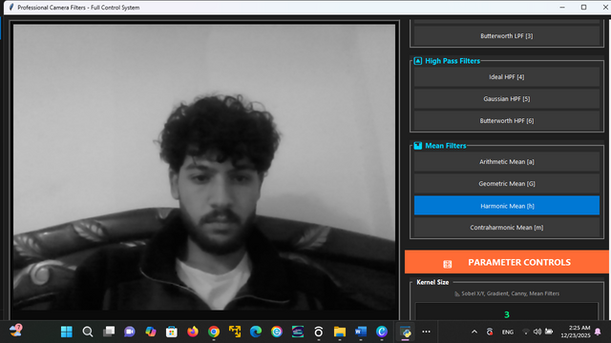
gEOMETRIC MEAN
hARMONIC MEAN

